Slide 1
Module 4:
Shor’s algorithm and Grover Search algorithm
Prof. Abhishek Dixit
Dept. of Electrical Engineering
IIT Delhi

Slide 2
Outline
Shor’s algorithm
Grover’s search algorithm

Slide 3
Outline
Shor’s algorithm
  Classical
  Shor’s algorithm
Grover’s search algorithm

Slide 4
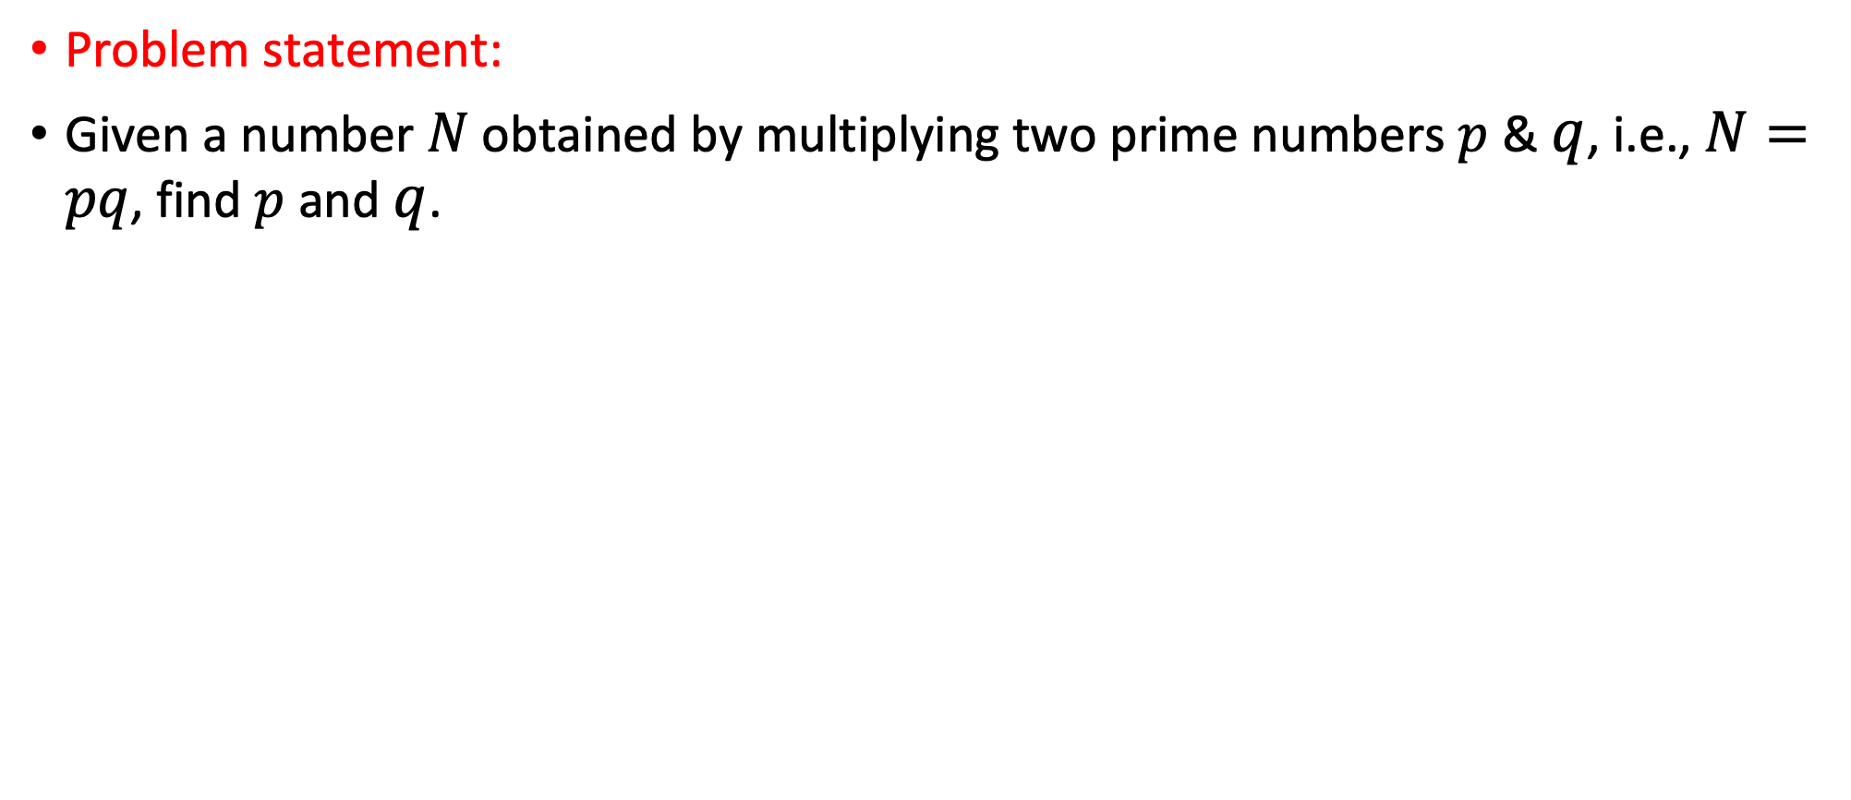
Shor’s algorithm
Problem statement:
Given a number $N$ obtained by multiplying two prime numbers $p$ & $q$, i.e., $N=pq$, find $p$ and $q$.

Slide 5
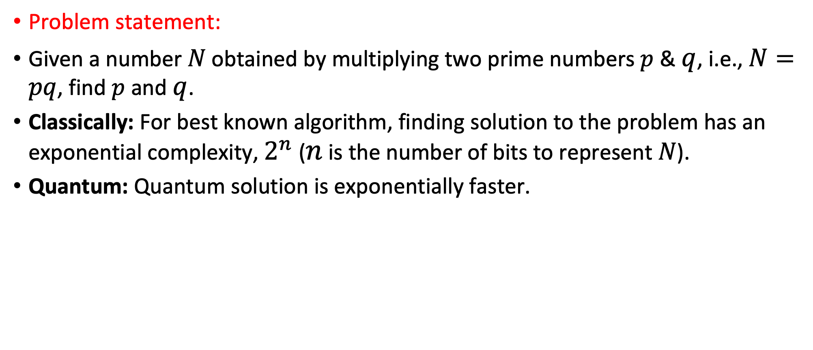
Shor’s algorithm
Problem statement:
Given a number $N$ obtained by multiplying two prime numbers $p$ & $q$, i.e., $N=pq$, find $p$ and $q$.
Classically: For best known algorithm, finding solution to the problem has an exponential complexity, $2^{n}$ ($n$ is the number of bits to represent $N$).
Quantum: Quantum solution is exponentially faster.

Slide 6
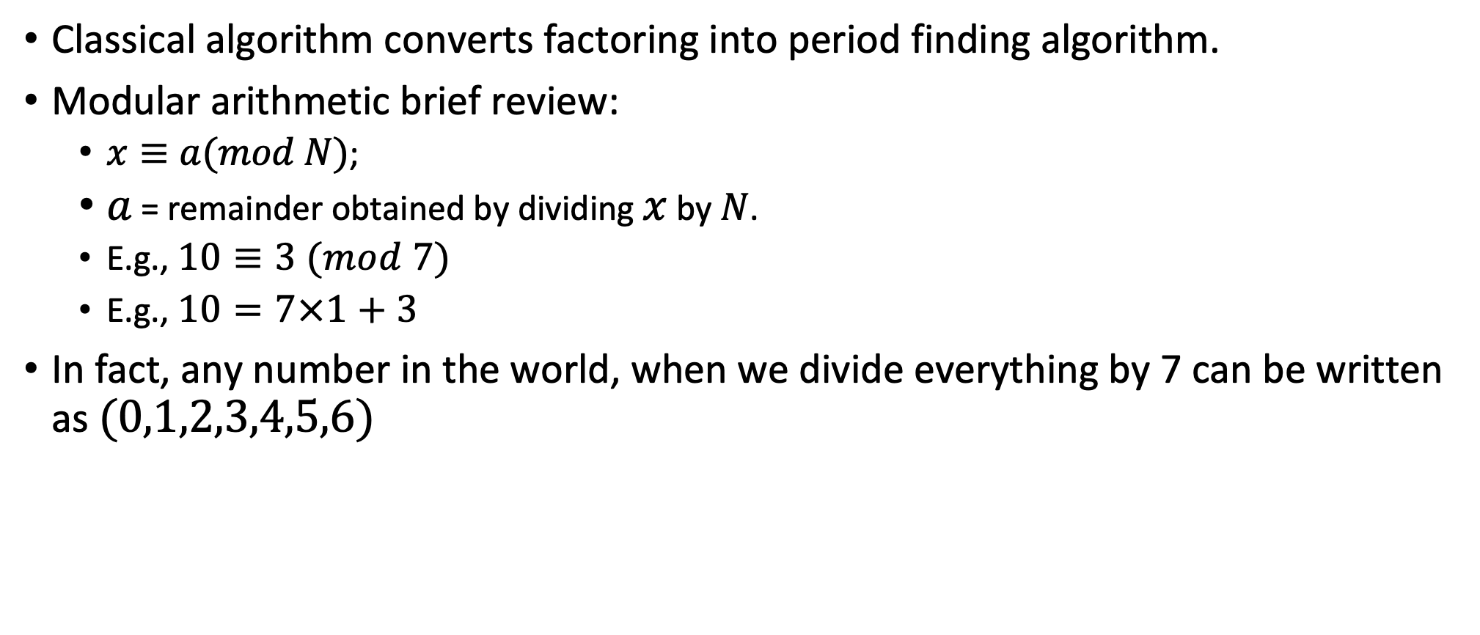
Modular arithmetic
Classical algorithm converts factoring into period finding algorithm.
Modular arithmetic brief review:
  $x≡a(mod N)$;
  $a$ = remainder obtained by dividing $x$ by $N$.
  E.g., $10≡3 (mod 7)$
  E.g., $10=7×1+3$
In fact, any number in the world, when we divide everything by 7 can be written as $(0,1,2,3,4,5,6)$

Slide 7
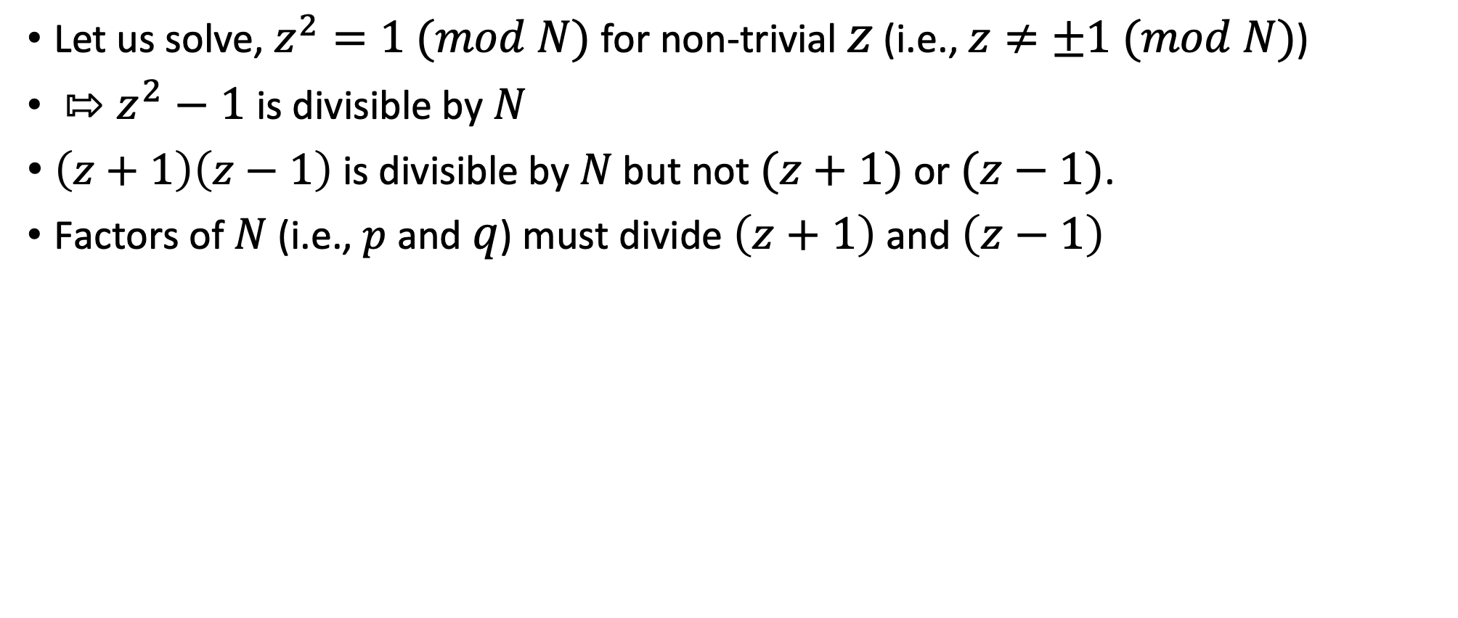
Modular arithmetic
Let us solve, $z^{2}=1 (mod N)$ for non-trivial $z$ (i.e., $z≠±1 (mod N)$)
${⇰ z}^{2}−1$ is divisible by $N$
$\left(z+1\right)\left(z−1\right)$ is divisible by $N$ but not $(z+1)$ or $(z−1)$.
Factors of $N$ (i.e., $p$ and $q$) must divide $\left(z+1\right)$ and $\left(z−1\right)$

Slide 8
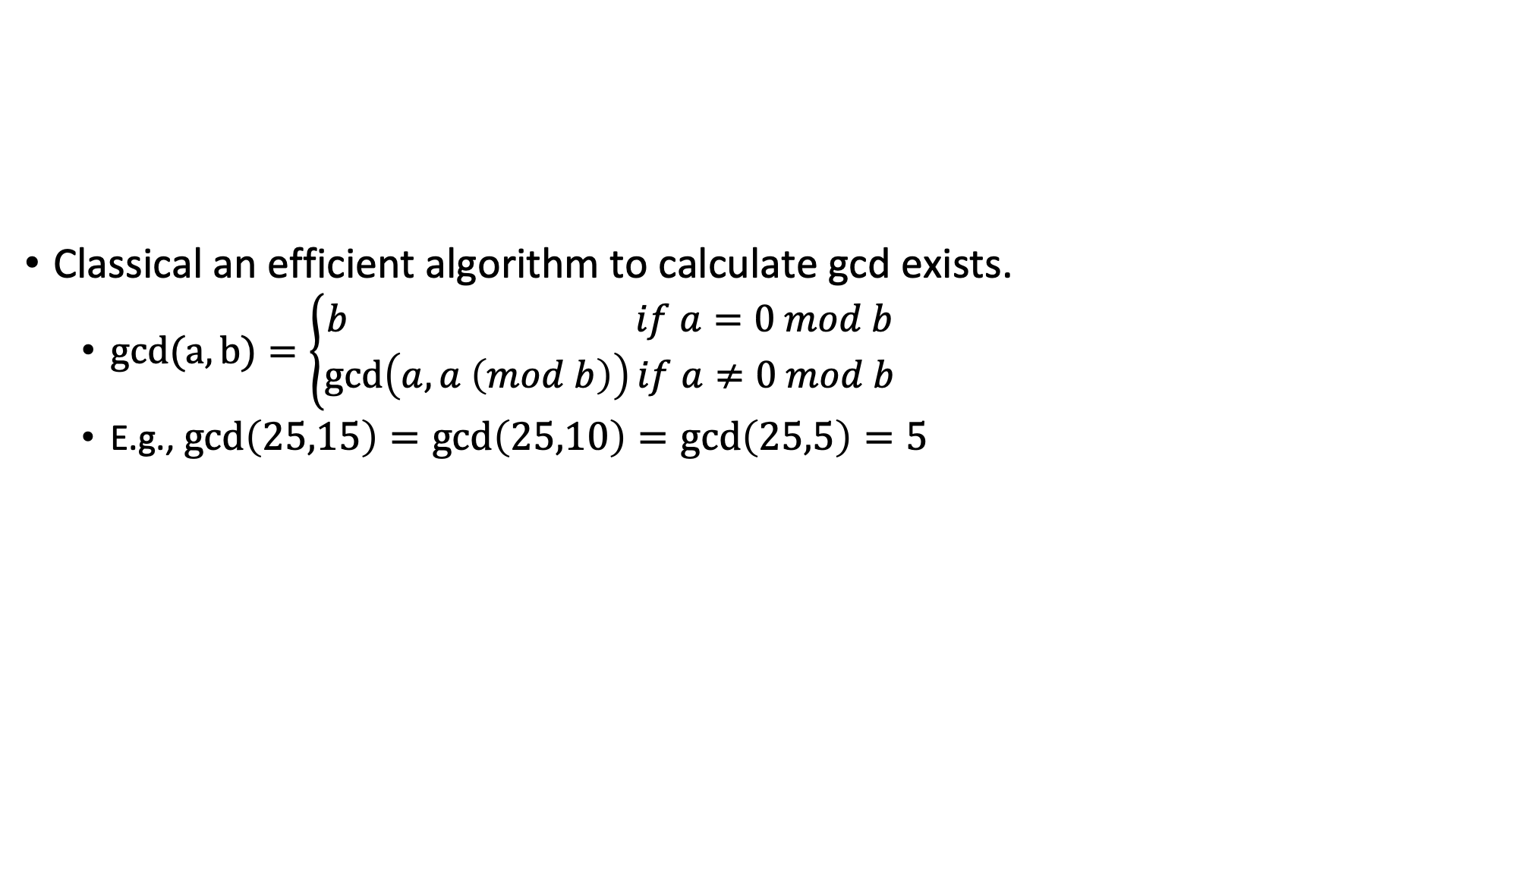
Euclidean algorithm
Classical an efficient algorithm to calculate gcd exists.
  $gcd(a,b)=\left\{\begin{aligned}b if a=0 mod b \\ \gcd\left(a,a \left(mod b\right)\right)if a≠0 mod b\end{aligned}\right.$
  E.g., $\gcd\left(25,15\right)=\gcd\left(25,10\right)=\gcd\left(25,5\right)=5$

Slide 9
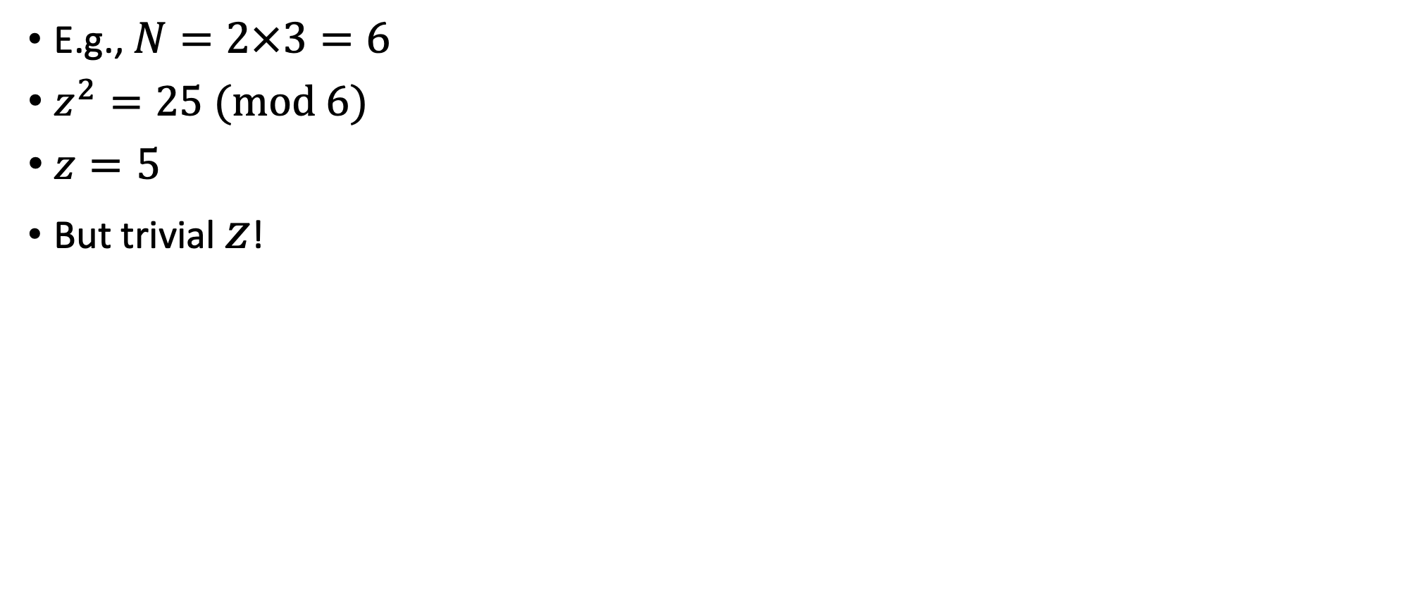
Modular arithmetic
E.g., $N=2×3=6$
$z^{2}=25 (mod 6)$
$z=5$
But trivial $z$!

Slide 10
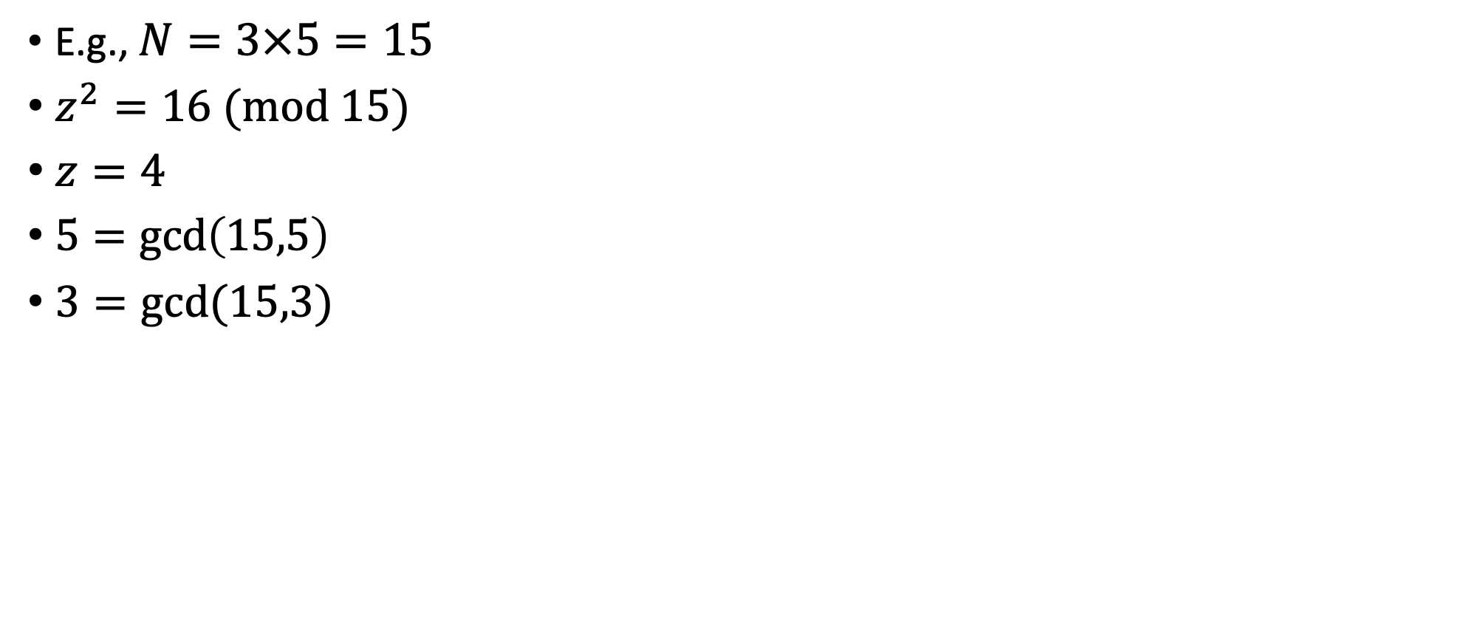
Modular arithmetic
E.g., $N=3×5=15$
$z^{2}=16 (mod 15)$
$z=4$
$5=\gcd\left(15,5\right)$
$3=gcd⁡(15,3)$

Slide 11
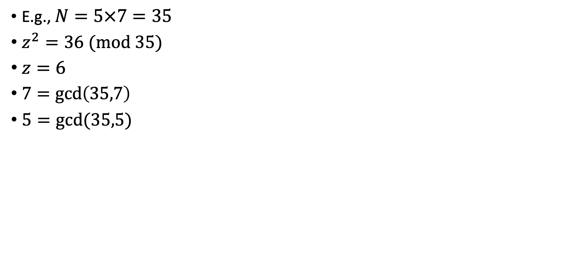
Modular arithmetic
E.g., $N=5×7=35$
$z^{2}=36 (mod 35)$
$z=6$
$7=\gcd\left(35,7\right)$
$5=gcd⁡(35,5)$

Slide 12
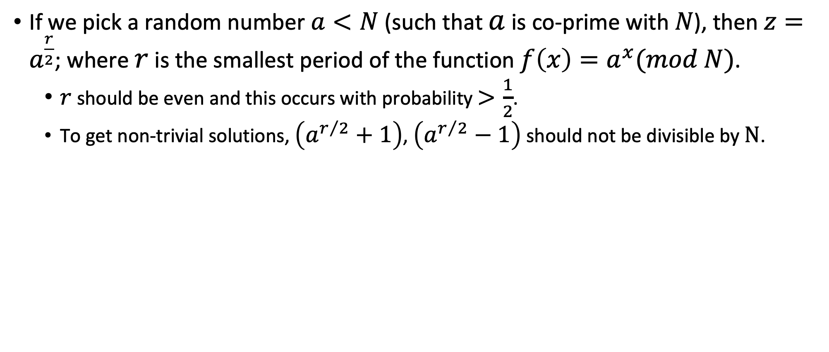
How to find z: $z^{2}=1 modN?$
If we pick a random number $a<N$ (such that $a$ is co-prime with $N$), then $z=a^{\frac{r}{2}}$; where $r$ is the smallest period of the function $f\left(x\right)=a^{x}(mod N)$.
  $r$ should be even and this occurs with probability $>\frac{1}{2}$.
  To get non-trivial solutions, $\left(a^{r/2}+1\right)$, $\left(a^{r/2}−1\right)$ should not be divisible by $N$.

Slide 13
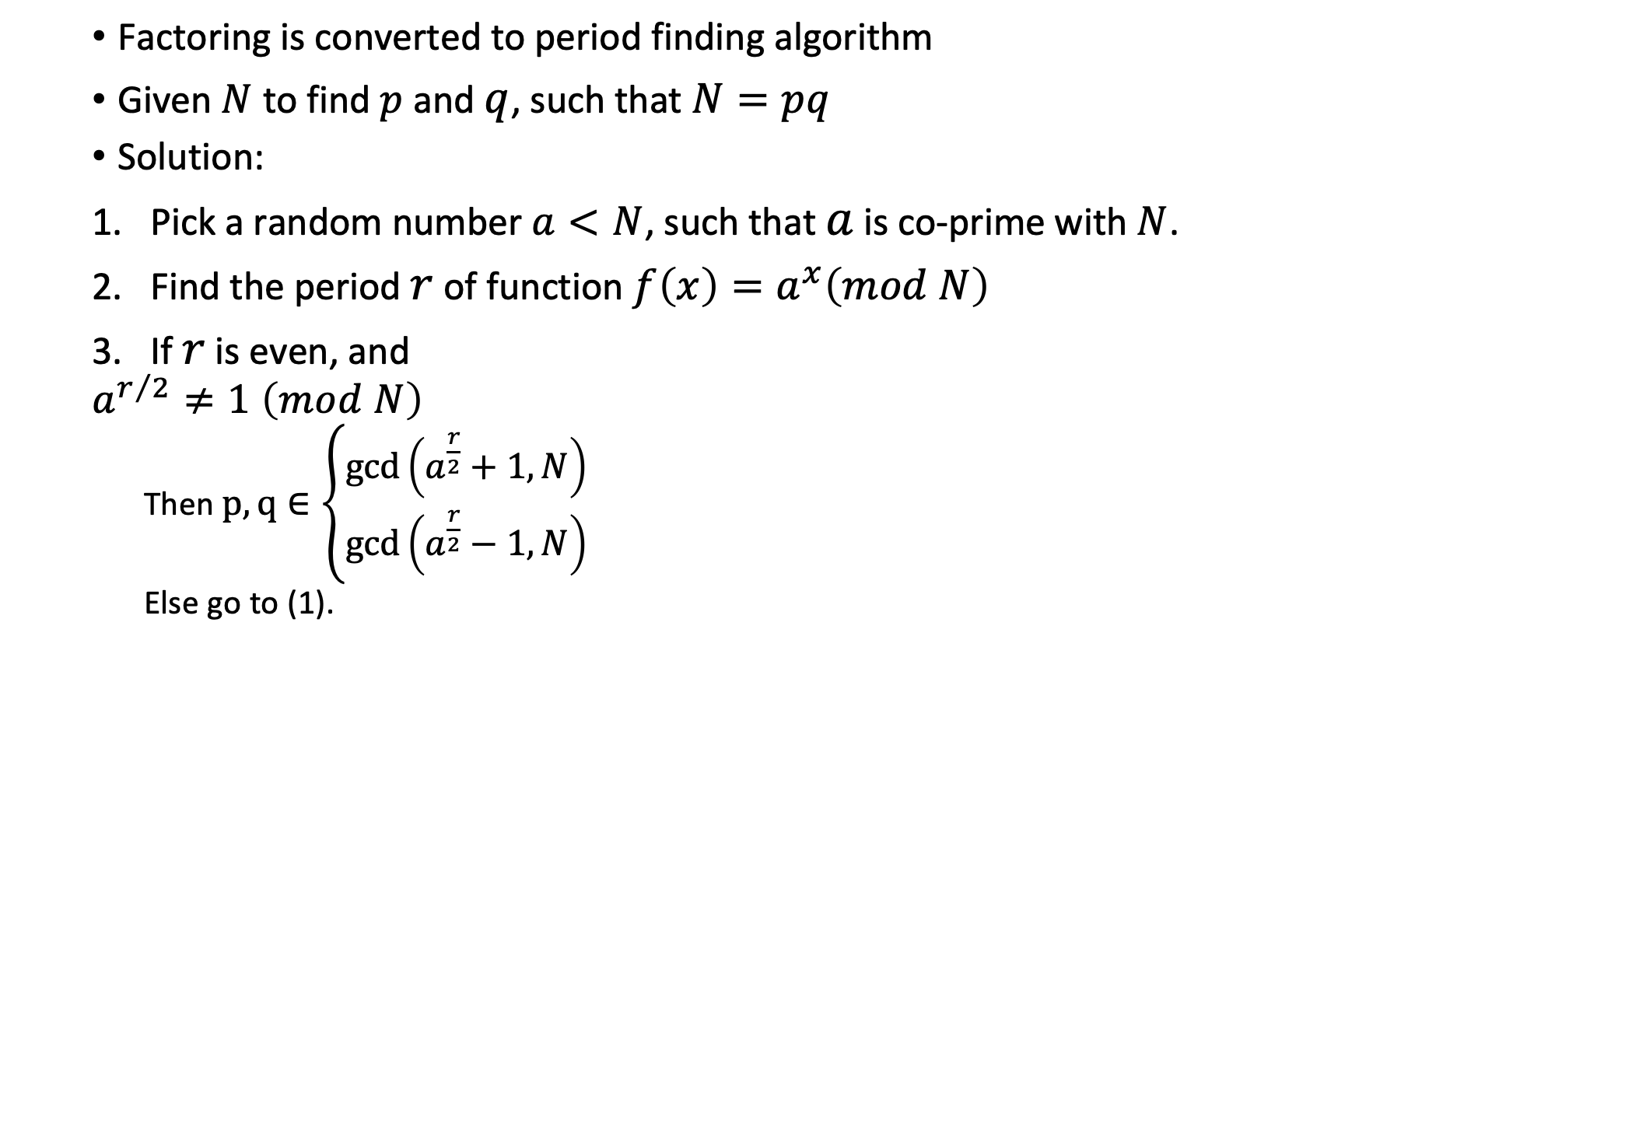
Summary of the classical algorithm
Factoring is converted to period finding algorithm
Given $N$ to find $p$ and $q$, such that $N=pq$
Solution:
Pick a random number $a<N$, such that $a$ is co-prime with $N$.
Find the period $r$ of function $f\left(x\right)=a^{x}\left(mod N\right)$
If $r$ is even, and
$$a^{r/2}≠1 \left(mod N\right)$$
  Then $p,q∈\left\{\begin{aligned}\gcd\left(a^{\frac{r}{2}}+1,N\right) \\ \gcd\left(a^{\frac{r}{2}}−1,N\right)\end{aligned}\right.$
  Else go to (1).

Slide 14

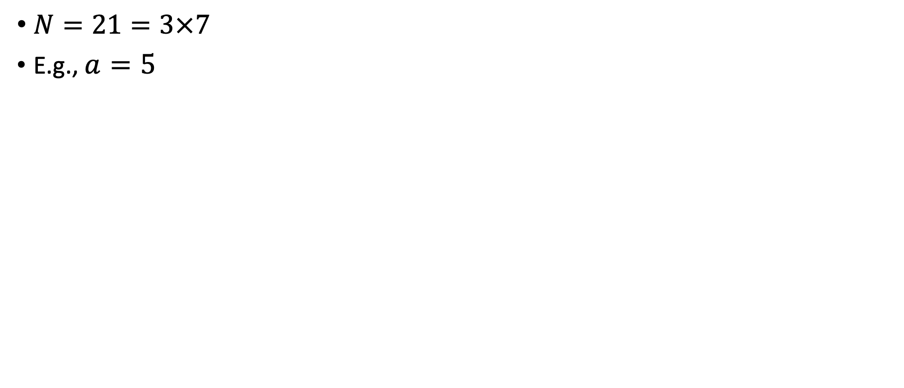
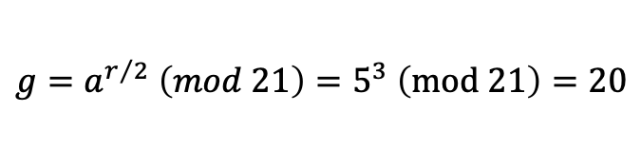


Summary of the classical algorithm
$N=21=3×7$
E.g., $a=5$
$$5^{x}$$
$$5^{x}(mod 21)$$
$$r=6$$
$$g=a^{r/2} \left(mod 21\right)=5^{3} \left(mod 21\right)=20$$

Slide 15



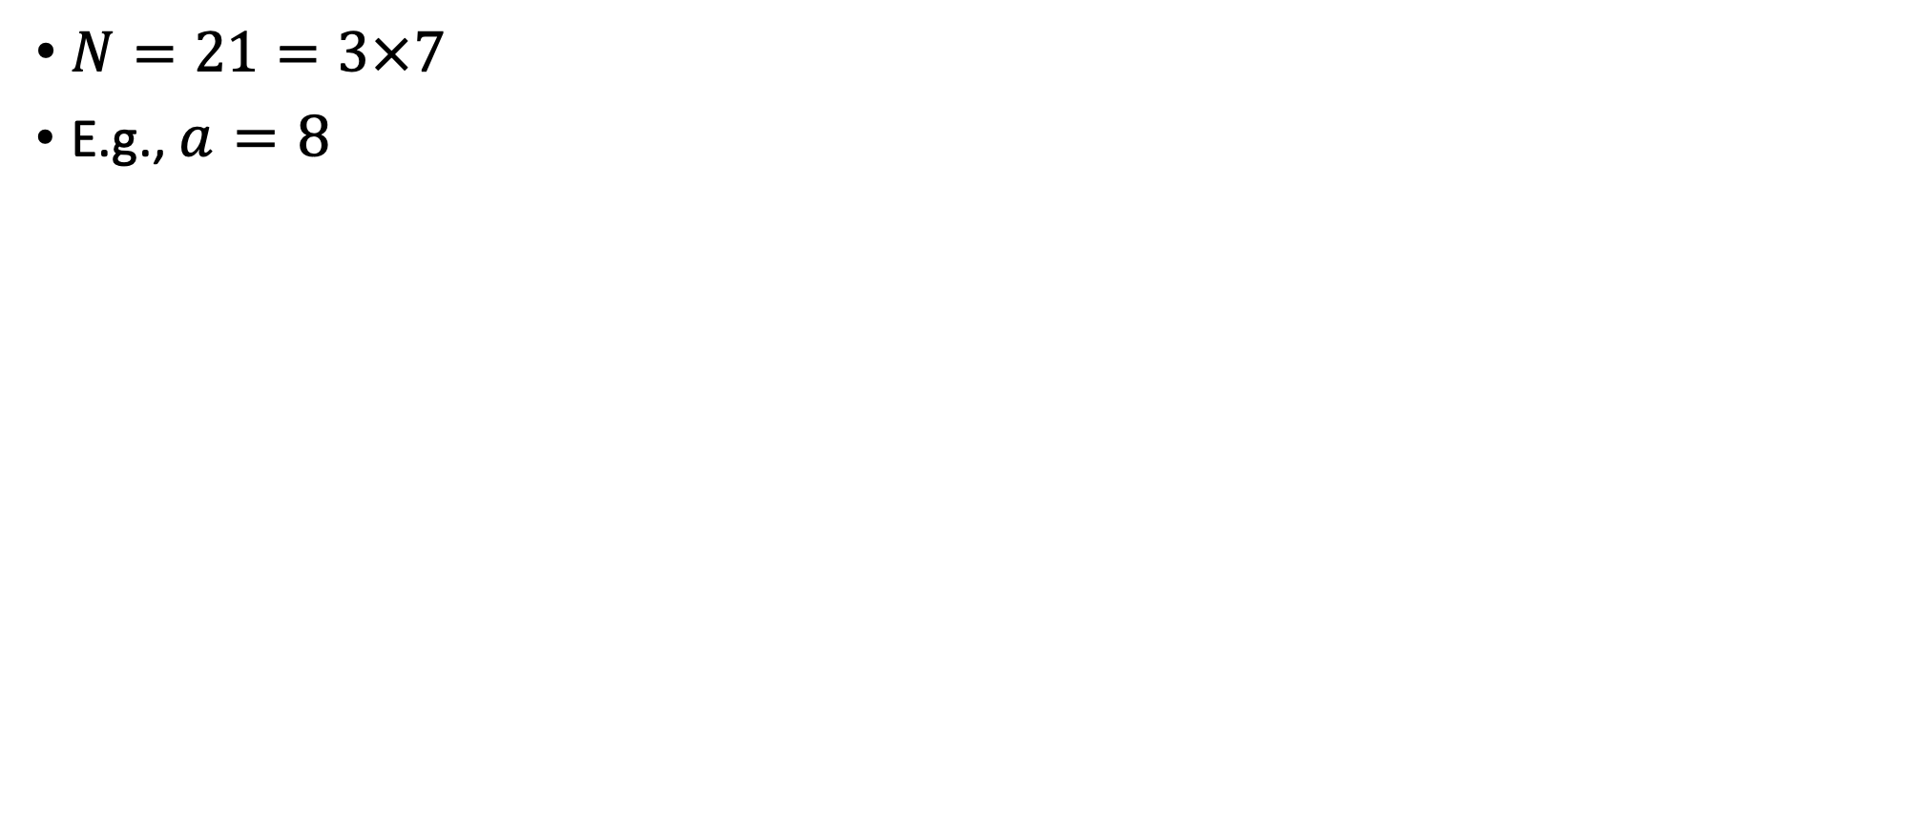
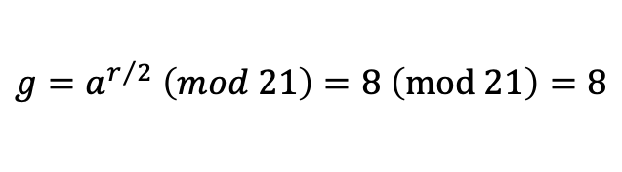


Summary of the classical algorithm
$N=21=3×7$
E.g., $a=8$
$$8^{x}$$
$$8^{x}(mod 21)$$
$$r=2$$
$$g=a^{r/2} \left(mod 21\right)=8 \left(mod 21\right)=8$$
$$3=\gcd\left(9,21\right)$$
$$7=\gcd\left(7,21\right)$$

Slide 16
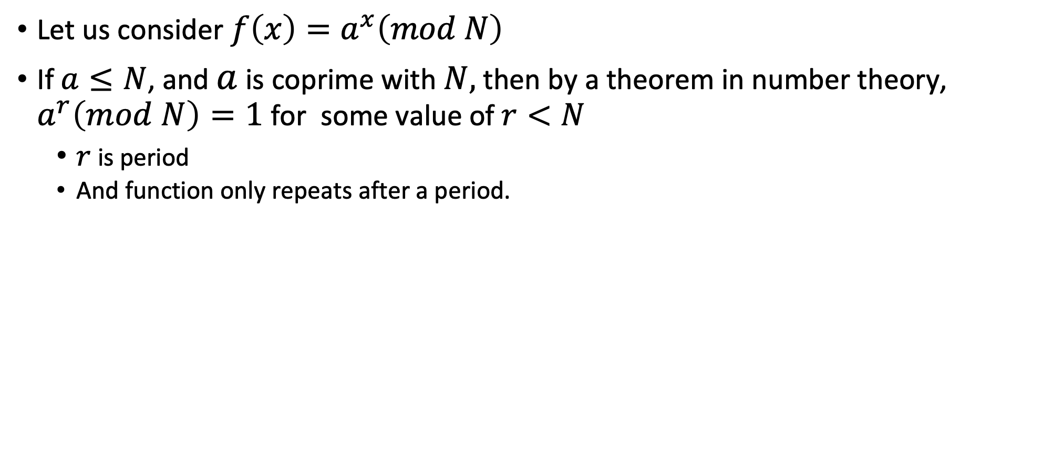
Some comments about function
Let us consider $f\left(x\right)=a^{x}\left(mod N\right)$
If $a≤N$, and $a$ is coprime with $N,$ then by a theorem in number theory, $a^{r}\left(mod N\right)=1$ for some value of $r<N$
  $r$ is period
  And function only repeats after a period.

Slide 17
Outline
Shor’s algorithm
  Classical
  Shor’s algorithm
Grover’s search algorithm

Slide 18
Summary of the classical algorithm
Factoring is converted to period finding algorithm
Given $N$ to find $p$ and $q$, such that $N=pq$
Solution:
Pick a random number $a<N$, such that $a$ is co-prime with $N$.
Find the period $r$ of function $f\left(x\right)=a^{x}\left(mod N\right)$
If $r$ is even, and
$$a^{r/2}≠1 \left(mod N\right)$$
  Then $p,q∈\left\{\begin{aligned}\gcd\left(a^{\frac{r}{2}}+1,N\right) \\ \gcd\left(a^{\frac{r}{2}}−1,N\right)\end{aligned}\right.$
  Else go to (1).
Shor’s algorithm

Slide 19
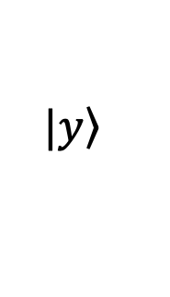
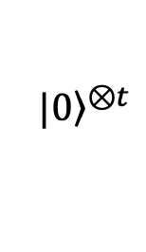

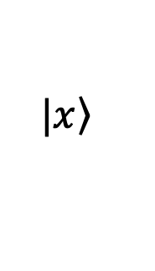
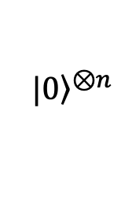



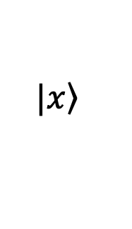
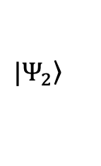
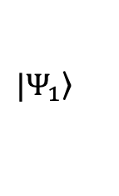
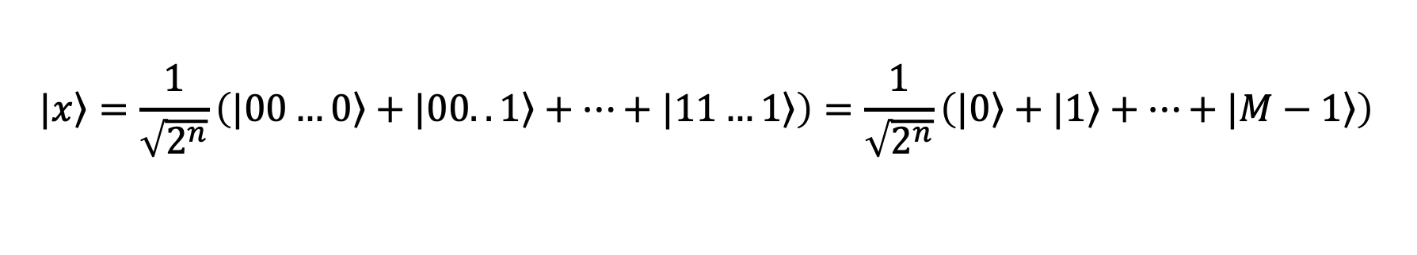

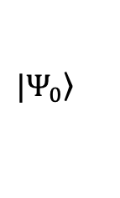
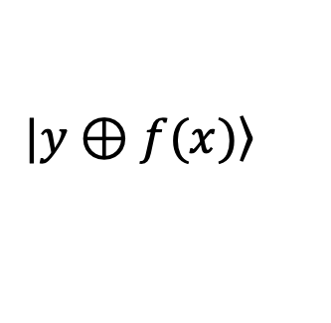
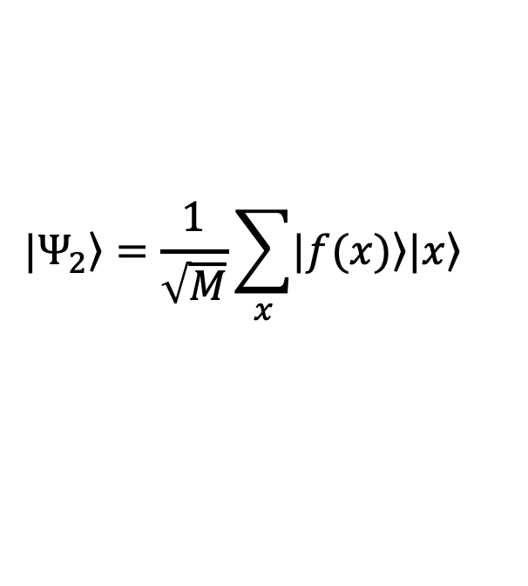
Shor’s algorithm
$$|{\left.0\right\rangle }^{⊗n}$$
$$\left.|x\right\rangle$$
$$\left.|x\right\rangle$$
$$H^{⊗n}$$
$$QFT$$
$$f=a^{x}(mod N)$$
$$\left.|y\right\rangle$$
$$\left.|y⊕f(x)\right\rangle$$
$$t=\left\lceil \log_{2}{N}\right\rceil$$
$$|{\left.0\right\rangle }^{⊗t}$$
$$|\left.Ψ_{0}\right\rangle$$
$$|\left.Ψ_{1}\right\rangle$$
$$|\left.Ψ_{2}\right\rangle$$
$$|\left.x\right\rangle =\frac{1}{\sqrt{2^{n}}}\left(|\left.00…0\right\rangle +|\left.00..1\right\rangle +…+|\left.11…1\right\rangle \right)=\frac{1}{\sqrt{2^{n}}}\left(|\left.0\right\rangle +|\left.1\right\rangle +…+|\left.M−1\right\rangle \right)$$
$$|\left.Ψ_{2}\right\rangle =\frac{1}{\sqrt{M}}\sum_{x}{\left.|f(x)\right\rangle |\left.x\right\rangle }$$
$$M=2^{n}$$

Slide 20
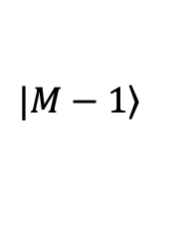

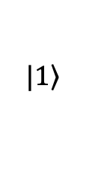
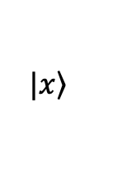

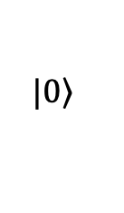
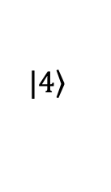
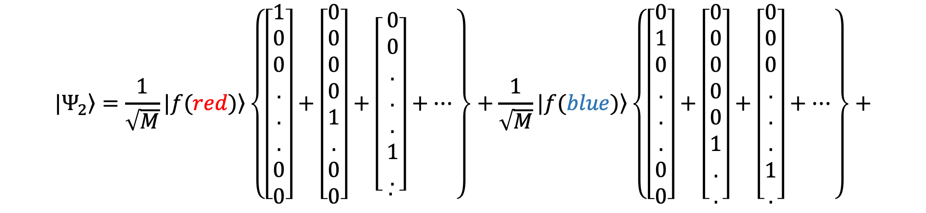
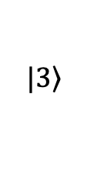

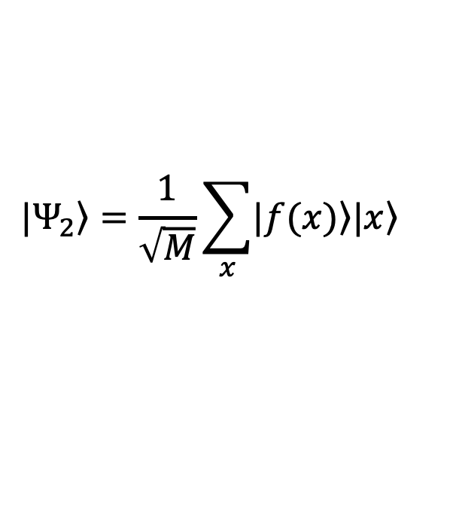
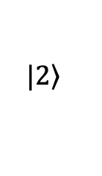


Shor’s algorithm
$$a^{x}(mod N)$$
. . .
$$|\left.0\right\rangle$$
$$|\left.1\right\rangle$$
$$|\left.2\right\rangle$$
$$|\left.3\right\rangle$$
$$|\left.4\right\rangle$$
$$|\left.M−1\right\rangle$$
$$|\left.x\right\rangle$$
$$|\left.Ψ_{2}\right\rangle =\frac{1}{\sqrt{M}}\sum_{x}{\left.|f(x)\right\rangle |\left.x\right\rangle }$$
$$|\left.Ψ_{2}\right\rangle =\frac{1}{\sqrt{M}}\left.|f(red)\right\rangle \left\{\left[\begin{aligned}1 \\ 0 \\ 0 \\ . \\ . \\ . \\ 0 \\ 0\end{aligned}\right]+\left[\begin{aligned}0 \\ 0 \\ 0 \\ 0 \\ 1 \\ . \\ 0 \\ 0\end{aligned}\right]+\left[\begin{aligned} \begin{aligned}0 \\ 0 \\ . \\ . \\ . \\ 1 \\ .\end{aligned} \\ .\end{aligned}\right]+…\right\}+\frac{1}{\sqrt{M}}\left.|f(blue)\right\rangle \left\{\left[\begin{aligned}0 \\ 1 \\ 0 \\ . \\ . \\ . \\ 0 \\ 0\end{aligned}\right]+\left[\begin{aligned}0 \\ 0 \\ 0 \\ 0 \\ 0 \\ 1 \\ . \\ .\end{aligned}\right]+\left[\begin{aligned}0 \\ 0 \\ 0 \\ . \\ . \\ . \\ 1 \\ .\end{aligned}\right]+…\right\}+$$
$$r$$
$$r$$
$$r$$
$$r$$

Slide 21
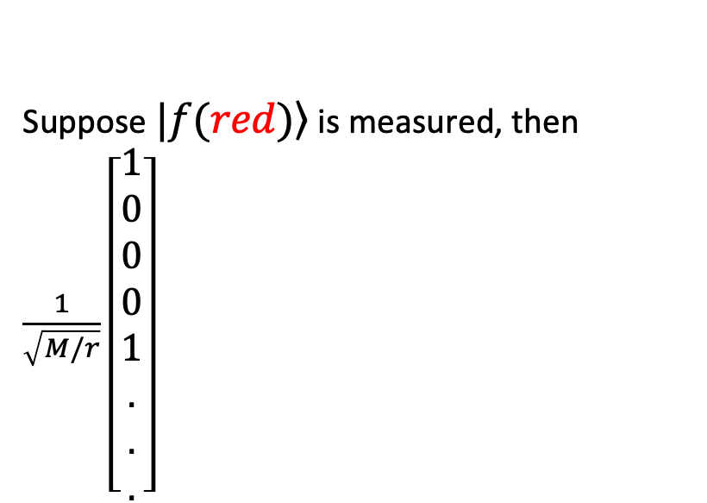

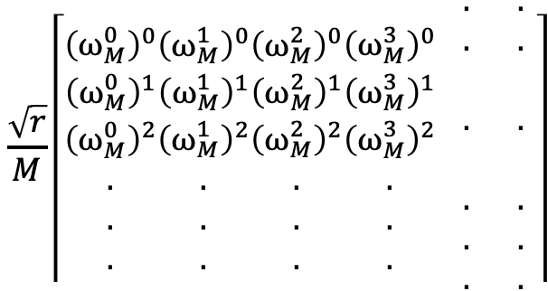
Shor’s algorithm
Suppose $\left.|f(red)\right\rangle$ is measured, then $\frac{1}{\sqrt{M/r}}\left[\begin{aligned}1 \\ 0 \\ 0 \\ 0 \\ 1 \\ . \\ . \\ .\end{aligned}\right]$
$$\frac{\sqrt{r}}{M}\left\lceil \begin{aligned}{\left(ω_{M}^{0}\right)}^{0} \\ {\left(ω_{M}^{0}\right)}^{1} \\ {\left(ω_{M}^{0}\right)}^{2} \\ . \\ . \\ .\end{aligned}\begin{aligned}{\left(ω_{M}^{1}\right)}^{0} \\ {\left(ω_{M}^{1}\right)}^{1} \\ {\left(ω_{M}^{1}\right)}^{2} \\ . \\ . \\ .\end{aligned}\begin{aligned}{\left(ω_{M}^{2}\right)}^{0} \\ {\left(ω_{M}^{2}\right)}^{1} \\ {\left(ω_{M}^{2}\right)}^{2} \\ . \\ . \\ .\end{aligned}\begin{aligned}{\left(ω_{M}^{3}\right)}^{0} \\ {\left(ω_{M}^{3}\right)}^{1} \\ {\left(ω_{M}^{3}\right)}^{2} \\ . \\ . \\ .\end{aligned} \begin{aligned}. \\ . \\ \\ . \\ \\ . \\ . \\ .\end{aligned} \begin{aligned}. \\ . \\ \\ . \\ \\ . \\ . \\ .\end{aligned}\right\rceil$$
$$\left[\begin{aligned}1 \\ 0 \\ 0 \\ 0 \\ 1 \\ . \\ . \\ .\end{aligned}\right]$$
$$r$$
$${\left(ω_{M}^{0}\right)}^{0}+{\left(ω_{M}^{r}\right)}^{0}+{\left(ω_{M}^{2r}\right)}^{0}+…+{\left(ω_{M}^{\left(\frac{M}{r}−1\right)r}\right)}^{0}=1+1+1+…+1=\frac{M}{r}$$

Slide 22
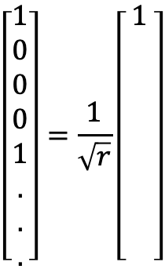
Shor’s algorithm
Suppose $\left.|f(red)\right\rangle$ is measured, then $\frac{1}{\sqrt{M/r}}\left[\begin{aligned}1 \\ 0 \\ 0 \\ 0 \\ 1 \\ . \\ . \\ .\end{aligned}\right]$
$$\frac{\sqrt{r}}{M}\left\lceil \begin{aligned}{\left(ω_{M}^{0}\right)}^{0} \\ {\left(ω_{M}^{0}\right)}^{1} \\ {\left(ω_{M}^{0}\right)}^{2} \\ . \\ . \\ .\end{aligned}\begin{aligned}{\left(ω_{M}^{1}\right)}^{0} \\ {\left(ω_{M}^{1}\right)}^{1} \\ {\left(ω_{M}^{1}\right)}^{2} \\ . \\ . \\ .\end{aligned}\begin{aligned}{\left(ω_{M}^{2}\right)}^{0} \\ {\left(ω_{M}^{2}\right)}^{1} \\ {\left(ω_{M}^{2}\right)}^{2} \\ . \\ . \\ .\end{aligned}\begin{aligned}{\left(ω_{M}^{3}\right)}^{0} \\ {\left(ω_{M}^{3}\right)}^{1} \\ {\left(ω_{M}^{3}\right)}^{2} \\ . \\ . \\ .\end{aligned} \begin{aligned}. \\ . \\ \\ . \\ \\ . \\ . \\ .\end{aligned} \begin{aligned}. \\ . \\ \\ . \\ \\ . \\ . \\ .\end{aligned}\right\rceil$$
$$\left[\begin{aligned}1 \\ 0 \\ 0 \\ 0 \\ 1 \\ . \\ . \\ .\end{aligned}\right]=\frac{1}{\sqrt{r}}\left[\begin{aligned}1 \\ \\ \\ \\ \\ \\ \\ \end{aligned}\right]$$
$$r$$
$${\left(ω_{M}^{0}\right)}^{0}+{\left(ω_{M}^{r}\right)}^{0}+{\left(ω_{M}^{2r}\right)}^{0}+…+{\left(ω_{M}^{\left(\frac{M}{r}−1\right)r}\right)}^{0}=1+1+1+…+1=\frac{M}{r}$$

Slide 23
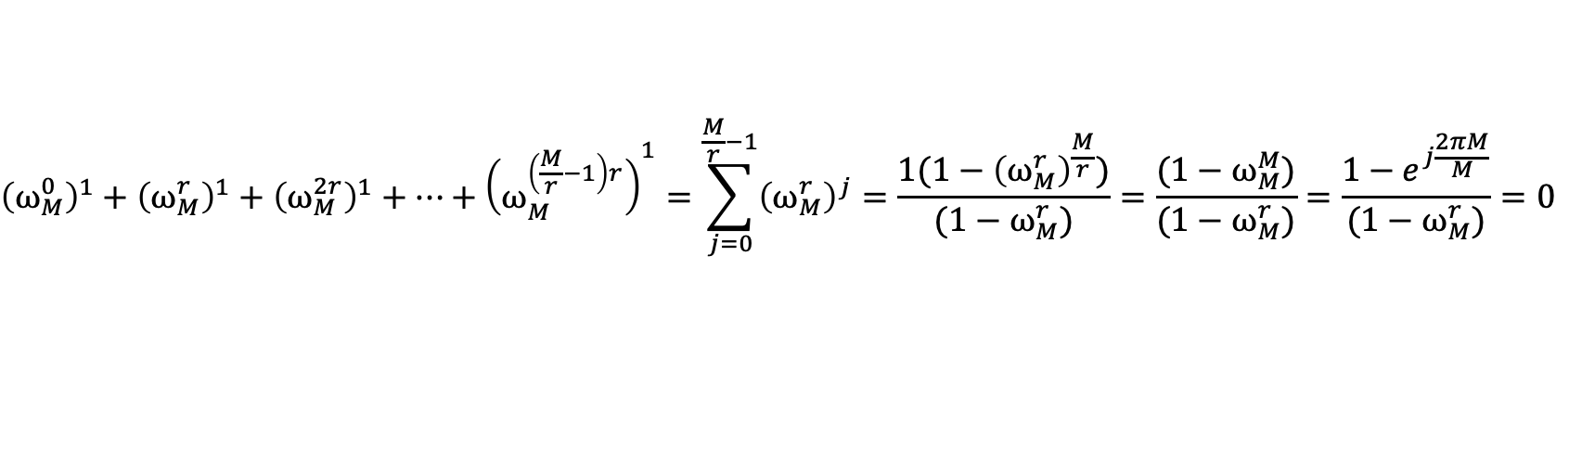
Shor’s algorithm
Suppose $\left.|f(red)\right\rangle$ is measured, then $\frac{1}{\sqrt{M/r}}\left[\begin{aligned}1 \\ 0 \\ 0 \\ 0 \\ 1 \\ . \\ . \\ .\end{aligned}\right]$
$$\frac{\sqrt{r}}{M}\left\lceil \begin{aligned}{\left(ω_{M}^{0}\right)}^{0} \\ {\left(ω_{M}^{0}\right)}^{1} \\ {\left(ω_{M}^{0}\right)}^{2} \\ . \\ . \\ .\end{aligned}\begin{aligned}{\left(ω_{M}^{1}\right)}^{0} \\ {\left(ω_{M}^{1}\right)}^{1} \\ {\left(ω_{M}^{1}\right)}^{2} \\ . \\ . \\ .\end{aligned}\begin{aligned}{\left(ω_{M}^{2}\right)}^{0} \\ {\left(ω_{M}^{2}\right)}^{1} \\ {\left(ω_{M}^{2}\right)}^{2} \\ . \\ . \\ .\end{aligned}\begin{aligned}{\left(ω_{M}^{3}\right)}^{0} \\ {\left(ω_{M}^{3}\right)}^{1} \\ {\left(ω_{M}^{3}\right)}^{2} \\ . \\ . \\ .\end{aligned} \begin{aligned}. \\ . \\ \\ . \\ \\ . \\ . \\ .\end{aligned} \begin{aligned}. \\ . \\ \\ . \\ \\ . \\ . \\ .\end{aligned}\right\rceil$$
$$\left[\begin{aligned}1 \\ 0 \\ 0 \\ 0 \\ 1 \\ . \\ . \\ .\end{aligned}\right]=\frac{1}{\sqrt{r}}\left[\begin{aligned}1 \\ \\ \\ \\ \\ \\ \\ \end{aligned}\right]$$
$$r$$
$${\left(ω_{M}^{0}\right)}^{1}+{\left(ω_{M}^{r}\right)}^{1}+{\left(ω_{M}^{2r}\right)}^{1}+…+{\left(ω_{M}^{\left(\frac{M}{r}−1\right)r}\right)}^{1}=\sum_{j=0}^{\frac{M}{r}−1}{{\left(ω_{M}^{r}\right)}^{j}}=\frac{1(1−{\left(ω_{M}^{r}\right)}^{\frac{M}{r}}\text{)}}{(1−ω_{M}^{r}\text{)}}=\frac{(1−ω_{M}^{M}\text{)}}{(1−ω_{M}^{r}\text{)}}=\frac{1−e^{j\frac{2πM}{M}}}{(1−ω_{M}^{r}\text{)}}=0$$

Slide 24
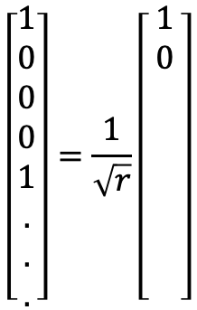
Shor’s algorithm
Suppose $\left.|f(red)\right\rangle$ is measured, then $\frac{1}{\sqrt{M/r}}\left[\begin{aligned}1 \\ 0 \\ 0 \\ 0 \\ 1 \\ . \\ . \\ .\end{aligned}\right]$
$$\frac{\sqrt{r}}{M}\left\lceil \begin{aligned}{\left(ω_{M}^{0}\right)}^{0} \\ {\left(ω_{M}^{0}\right)}^{1} \\ {\left(ω_{M}^{0}\right)}^{2} \\ . \\ . \\ .\end{aligned}\begin{aligned}{\left(ω_{M}^{1}\right)}^{0} \\ {\left(ω_{M}^{1}\right)}^{1} \\ {\left(ω_{M}^{1}\right)}^{2} \\ . \\ . \\ .\end{aligned}\begin{aligned}{\left(ω_{M}^{2}\right)}^{0} \\ {\left(ω_{M}^{2}\right)}^{1} \\ {\left(ω_{M}^{2}\right)}^{2} \\ . \\ . \\ .\end{aligned}\begin{aligned}{\left(ω_{M}^{3}\right)}^{0} \\ {\left(ω_{M}^{3}\right)}^{1} \\ {\left(ω_{M}^{3}\right)}^{2} \\ . \\ . \\ .\end{aligned} \begin{aligned}. \\ . \\ \\ . \\ \\ . \\ . \\ .\end{aligned} \begin{aligned}. \\ . \\ \\ . \\ \\ . \\ . \\ .\end{aligned}\right\rceil$$
$$\left[\begin{aligned}1 \\ 0 \\ 0 \\ 0 \\ 1 \\ . \\ . \\ .\end{aligned}\right]=\frac{1}{\sqrt{r}}\left[\begin{aligned}1 \\ 0 \\ \\ \\ \\ \\ \\ \end{aligned}\right]$$
$$r$$
$${\left(ω_{M}^{0}\right)}^{1}+{\left(ω_{M}^{r}\right)}^{1}+{\left(ω_{M}^{2r}\right)}^{1}+…+{\left(ω_{M}^{\left(\frac{M}{r}−1\right)r}\right)}^{1}=\sum_{j=0}^{\frac{M}{r}−1}{{\left(ω_{M}^{r}\right)}^{j}}=\frac{1(1−{\left(ω_{M}^{r}\right)}^{\frac{M}{r}}\text{)}}{(1−ω_{M}^{r}\text{)}}=\frac{(1−ω_{M}^{M}\text{)}}{(1−ω_{M}^{r}\text{)}}=\frac{1−e^{j\frac{2πM}{M}}}{(1−ω_{M}^{r}\text{)}}=0$$

Slide 25
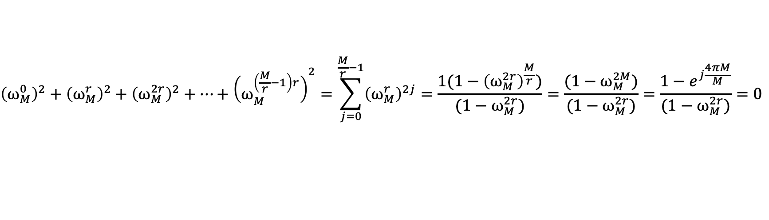
Shor’s algorithm
Suppose $\left.|f(red)\right\rangle$ is measured, then $\frac{1}{\sqrt{M/r}}\left[\begin{aligned}1 \\ 0 \\ 0 \\ 0 \\ 1 \\ . \\ . \\ .\end{aligned}\right]$
$$\frac{\sqrt{r}}{M}\left\lceil \begin{aligned}{\left(ω_{M}^{0}\right)}^{0} \\ {\left(ω_{M}^{0}\right)}^{1} \\ {\left(ω_{M}^{0}\right)}^{2} \\ . \\ . \\ .\end{aligned}\begin{aligned}{\left(ω_{M}^{1}\right)}^{0} \\ {\left(ω_{M}^{1}\right)}^{1} \\ {\left(ω_{M}^{1}\right)}^{2} \\ . \\ . \\ .\end{aligned}\begin{aligned}{\left(ω_{M}^{2}\right)}^{0} \\ {\left(ω_{M}^{2}\right)}^{1} \\ {\left(ω_{M}^{2}\right)}^{2} \\ . \\ . \\ .\end{aligned}\begin{aligned}{\left(ω_{M}^{3}\right)}^{0} \\ {\left(ω_{M}^{3}\right)}^{1} \\ {\left(ω_{M}^{3}\right)}^{2} \\ . \\ . \\ .\end{aligned} \begin{aligned}. \\ . \\ \\ . \\ \\ . \\ . \\ .\end{aligned} \begin{aligned}. \\ . \\ \\ . \\ \\ . \\ . \\ .\end{aligned}\right\rceil$$
$$\left[\begin{aligned}1 \\ 0 \\ 0 \\ 0 \\ 1 \\ . \\ . \\ .\end{aligned}\right]=\frac{1}{\sqrt{r}}\left[\begin{aligned}1 \\ 0 \\ \\ \\ \\ \\ \\ \end{aligned}\right]$$
$$r$$
$${\left(ω_{M}^{0}\right)}^{2}+{\left(ω_{M}^{r}\right)}^{2}+{\left(ω_{M}^{2r}\right)}^{2}+…+{\left(ω_{M}^{\left(\frac{M}{r}−1\right)r}\right)}^{2}=\sum_{j=0}^{\frac{M}{r}−1}{{\left(ω_{M}^{r}\right)}^{2j}}=\frac{1(1−{\left(ω_{M}^{2r}\right)}^{\frac{M}{r}}\text{)}}{(1−ω_{M}^{2r}\text{)}}=\frac{(1−ω_{M}^{2M}\text{)}}{(1−ω_{M}^{2r}\text{)}}=\frac{1−e^{j\frac{4πM}{M}}}{(1−ω_{M}^{2r}\text{)}}=0$$

Slide 26
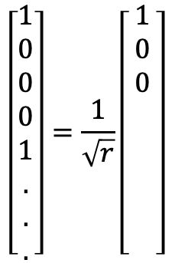
Shor’s algorithm
Suppose $\left.|f(red)\right\rangle$ is measured, then $\frac{1}{\sqrt{M/r}}\left[\begin{aligned}1 \\ 0 \\ 0 \\ 0 \\ 1 \\ . \\ . \\ .\end{aligned}\right]$
$$\frac{\sqrt{r}}{M}\left\lceil \begin{aligned}{\left(ω_{M}^{0}\right)}^{0} \\ {\left(ω_{M}^{0}\right)}^{1} \\ {\left(ω_{M}^{0}\right)}^{2} \\ . \\ . \\ .\end{aligned}\begin{aligned}{\left(ω_{M}^{1}\right)}^{0} \\ {\left(ω_{M}^{1}\right)}^{1} \\ {\left(ω_{M}^{1}\right)}^{2} \\ . \\ . \\ .\end{aligned}\begin{aligned}{\left(ω_{M}^{2}\right)}^{0} \\ {\left(ω_{M}^{2}\right)}^{1} \\ {\left(ω_{M}^{2}\right)}^{2} \\ . \\ . \\ .\end{aligned}\begin{aligned}{\left(ω_{M}^{3}\right)}^{0} \\ {\left(ω_{M}^{3}\right)}^{1} \\ {\left(ω_{M}^{3}\right)}^{2} \\ . \\ . \\ .\end{aligned} \begin{aligned}. \\ . \\ \\ . \\ \\ . \\ . \\ .\end{aligned} \begin{aligned}. \\ . \\ \\ . \\ \\ . \\ . \\ .\end{aligned}\right\rceil$$
$$\left[\begin{aligned}1 \\ 0 \\ 0 \\ 0 \\ 1 \\ . \\ . \\ .\end{aligned}\right]=\frac{1}{\sqrt{r}}\left[\begin{aligned}1 \\ 0 \\ 0 \\ \\ \\ \\ \\ \end{aligned}\right]$$
$$r$$
$${\left(ω_{M}^{0}\right)}^{2}+{\left(ω_{M}^{r}\right)}^{2}+{\left(ω_{M}^{2r}\right)}^{2}+…+{\left(ω_{M}^{\left(\frac{M}{r}−1\right)r}\right)}^{2}=\sum_{j=0}^{\frac{M}{r}−1}{{\left(ω_{M}^{r}\right)}^{2j}}=\frac{1(1−{\left(ω_{M}^{2r}\right)}^{\frac{M}{r}}\text{)}}{(1−ω_{M}^{2r}\text{)}}=\frac{(1−ω_{M}^{2M}\text{)}}{(1−ω_{M}^{2r}\text{)}}=\frac{1−e^{j\frac{4πM}{M}}}{(1−ω_{M}^{2r}\text{)}}=0$$

Slide 27


Shor’s algorithm
Suppose $\left.|f(red)\right\rangle$ is measured, then $\frac{1}{\sqrt{M/r}}\left[\begin{aligned}1 \\ 0 \\ 0 \\ 0 \\ 1 \\ . \\ . \\ .\end{aligned}\right]$
$$\frac{\sqrt{r}}{M}\left\lceil \begin{aligned}{\left(ω_{M}^{0}\right)}^{0} \\ {\left(ω_{M}^{0}\right)}^{1} \\ {\left(ω_{M}^{0}\right)}^{2} \\ . \\ . \\ .\end{aligned}\begin{aligned}{\left(ω_{M}^{1}\right)}^{0} \\ {\left(ω_{M}^{1}\right)}^{1} \\ {\left(ω_{M}^{1}\right)}^{2} \\ . \\ . \\ .\end{aligned}\begin{aligned}{\left(ω_{M}^{2}\right)}^{0} \\ {\left(ω_{M}^{2}\right)}^{1} \\ {\left(ω_{M}^{2}\right)}^{2} \\ . \\ . \\ .\end{aligned}\begin{aligned}{\left(ω_{M}^{3}\right)}^{0} \\ {\left(ω_{M}^{3}\right)}^{1} \\ {\left(ω_{M}^{3}\right)}^{2} \\ . \\ . \\ .\end{aligned} \begin{aligned}. \\ . \\ \\ . \\ \\ . \\ . \\ .\end{aligned} \begin{aligned}. \\ . \\ \\ . \\ \\ . \\ . \\ .\end{aligned}\right\rceil$$
$$\left[\begin{aligned}1 \\ 0 \\ 0 \\ 0 \\ 1 \\ . \\ . \\ .\end{aligned}\right]=\frac{1}{\sqrt{r}}\left[\begin{aligned}1 \\ 0 \\ 0 \\ \\ \\ \\ \\ \end{aligned}\right]$$
$$r$$
$${\left(ω_{M}^{0}\right)}^{2}+{\left(ω_{M}^{r}\right)}^{2}+{\left(ω_{M}^{2r}\right)}^{2}+…+{\left(ω_{M}^{\left(\frac{M}{r}−1\right)r}\right)}^{2}=\sum_{j=0}^{\frac{M}{r}−1}{{\left(ω_{M}^{r}\right)}^{2j}}=\frac{1(1−{\left(ω_{M}^{2r}\right)}^{\frac{M}{r}}\text{)}}{(1−ω_{M}^{2r}\text{)}}=\frac{(1−ω_{M}^{2M}\text{)}}{(1−ω_{M}^{2r}\text{)}}=\frac{1−e^{j\frac{4πM}{M}}}{(1−ω_{M}^{2r}\text{)}}=0$$
$$ω_{M}^{rc}=e^{j\frac{2πrc}{M}}=1$$
$$c=i\frac{M}{r}$$

Slide 28
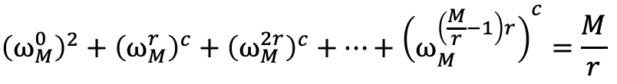
Shor’s algorithm
Suppose $\left.|f(red)\right\rangle$ is measured, then $\frac{1}{\sqrt{M/r}}\left[\begin{aligned}1 \\ 0 \\ 0 \\ 0 \\ 1 \\ . \\ . \\ .\end{aligned}\right]$
$$\frac{\sqrt{r}}{M}\left\lceil \begin{aligned}{\left(ω_{M}^{0}\right)}^{0} \\ {\left(ω_{M}^{0}\right)}^{1} \\ {\left(ω_{M}^{0}\right)}^{2} \\ . \\ . \\ .\end{aligned}\begin{aligned}{\left(ω_{M}^{1}\right)}^{0} \\ {\left(ω_{M}^{1}\right)}^{1} \\ {\left(ω_{M}^{1}\right)}^{2} \\ . \\ . \\ .\end{aligned}\begin{aligned}{\left(ω_{M}^{2}\right)}^{0} \\ {\left(ω_{M}^{2}\right)}^{1} \\ {\left(ω_{M}^{2}\right)}^{2} \\ . \\ . \\ .\end{aligned}\begin{aligned}{\left(ω_{M}^{3}\right)}^{0} \\ {\left(ω_{M}^{3}\right)}^{1} \\ {\left(ω_{M}^{3}\right)}^{2} \\ . \\ . \\ .\end{aligned} \begin{aligned}. \\ . \\ \\ . \\ \\ . \\ . \\ .\end{aligned} \begin{aligned}. \\ . \\ \\ . \\ \\ . \\ . \\ .\end{aligned}\right\rceil$$
$$\left[\begin{aligned}1 \\ 0 \\ 0 \\ 0 \\ 1 \\ . \\ . \\ .\end{aligned}\right]=\frac{1}{\sqrt{r}}\left[\begin{aligned}1 \\ 0 \\ 0 \\ \\ \\ \\ \\ \end{aligned}\right]$$
$$r$$
$${\left(ω_{M}^{0}\right)}^{2}+{\left(ω_{M}^{r}\right)}^{c}+{\left(ω_{M}^{2r}\right)}^{c}+…+{\left(ω_{M}^{\left(\frac{M}{r}−1\right)r}\right)}^{c}=\frac{M}{r}$$
$$ω_{M}^{rc}=e^{j\frac{2πrc}{M}}=1$$
$$c=i\frac{M}{r}$$

Slide 29
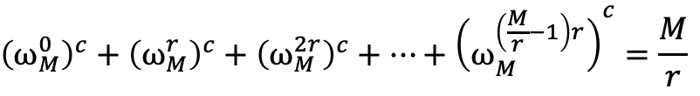
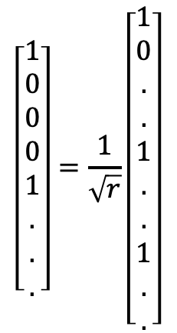


Shor’s algorithm
Suppose $\left.|f(red)\right\rangle$ is measured, then $\frac{1}{\sqrt{M/r}}\left[\begin{aligned}1 \\ 0 \\ 0 \\ 0 \\ 1 \\ . \\ . \\ .\end{aligned}\right]$
$$\frac{\sqrt{r}}{M}\left\lceil \begin{aligned}{\left(ω_{M}^{0}\right)}^{0} \\ {\left(ω_{M}^{0}\right)}^{1} \\ {\left(ω_{M}^{0}\right)}^{2} \\ . \\ . \\ .\end{aligned}\begin{aligned}{\left(ω_{M}^{1}\right)}^{0} \\ {\left(ω_{M}^{1}\right)}^{1} \\ {\left(ω_{M}^{1}\right)}^{2} \\ . \\ . \\ .\end{aligned}\begin{aligned}{\left(ω_{M}^{2}\right)}^{0} \\ {\left(ω_{M}^{2}\right)}^{1} \\ {\left(ω_{M}^{2}\right)}^{2} \\ . \\ . \\ .\end{aligned}\begin{aligned}{\left(ω_{M}^{3}\right)}^{0} \\ {\left(ω_{M}^{3}\right)}^{1} \\ {\left(ω_{M}^{3}\right)}^{2} \\ . \\ . \\ .\end{aligned} \begin{aligned}. \\ . \\ \\ . \\ \\ . \\ . \\ .\end{aligned} \begin{aligned}. \\ . \\ \\ . \\ \\ . \\ . \\ .\end{aligned}\right\rceil$$
$$\left[\begin{aligned}1 \\ 0 \\ 0 \\ 0 \\ 1 \\ . \\ . \\ .\end{aligned}\right]=\frac{1}{\sqrt{r}}\left[\begin{aligned}1 \\ 0 \\ . \\ . \\ 1 \\ . \\ . \\ 1 \\ . \\ .\end{aligned}\right]$$
$$r$$
$$M/r$$
$$M/r$$
$${\left(ω_{M}^{0}\right)}^{c}+{\left(ω_{M}^{r}\right)}^{c}+{\left(ω_{M}^{2r}\right)}^{c}+…+{\left(ω_{M}^{\left(\frac{M}{r}−1\right)r}\right)}^{c}=\frac{M}{r}$$
$$ω_{M}^{rc}=e^{j\frac{2πrc}{M}}=1$$
$$c=i\frac{M}{r}$$

Slide 30
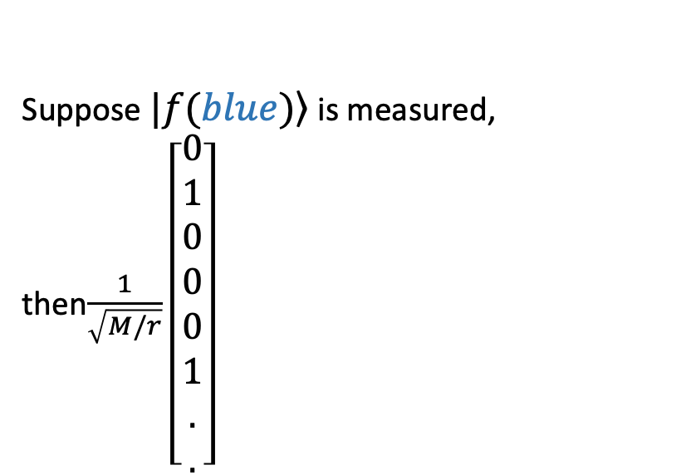
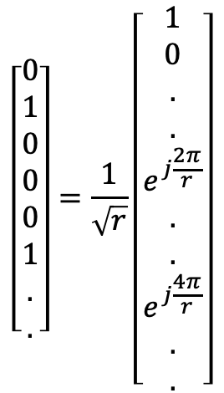
Shor’s algorithm
Suppose $\left.|f(blue)\right\rangle$ is measured, then$\frac{1}{\sqrt{M/r}}\left[\begin{aligned}0 \\ 1 \\ 0 \\ 0 \\ 0 \\ 1 \\ . \\ .\end{aligned}\right]$
$$\frac{\sqrt{r}}{M}\left\lceil \begin{aligned}{\left(ω_{M}^{0}\right)}^{0} \\ {\left(ω_{M}^{0}\right)}^{1} \\ {\left(ω_{M}^{0}\right)}^{2} \\ . \\ . \\ .\end{aligned}\begin{aligned}{\left(ω_{M}^{1}\right)}^{0} \\ {\left(ω_{M}^{1}\right)}^{1} \\ {\left(ω_{M}^{1}\right)}^{2} \\ . \\ . \\ .\end{aligned}\begin{aligned}{\left(ω_{M}^{2}\right)}^{0} \\ {\left(ω_{M}^{2}\right)}^{1} \\ {\left(ω_{M}^{2}\right)}^{2} \\ . \\ . \\ .\end{aligned}\begin{aligned}{\left(ω_{M}^{3}\right)}^{0} \\ {\left(ω_{M}^{3}\right)}^{1} \\ {\left(ω_{M}^{3}\right)}^{2} \\ . \\ . \\ .\end{aligned} \begin{aligned}. \\ . \\ \\ . \\ \\ . \\ . \\ .\end{aligned} \begin{aligned}. \\ . \\ \\ . \\ \\ . \\ . \\ .\end{aligned}\right\rceil$$
$$\left[\begin{aligned}0 \\ 1 \\ 0 \\ 0 \\ 0 \\ 1 \\ . \\ .\end{aligned}\right]=\frac{1}{\sqrt{r}}\left[\begin{aligned}1 \\ 0 \\ . \\ . \\ e^{j\frac{2π}{r}} \\ . \\ . \\ e^{j\frac{4π}{r}} \\ . \\ .\end{aligned}\right]$$
$$M/r$$
$$r$$
$$M/r$$
$${\left(ω_{M}^{1}\right)}^{0}+{\left(ω_{M}^{r+1}\right)}^{0}+{\left(ω_{M}^{2r+1}\right)}^{0}+…+{\left(ω_{M}^{\left(\frac{M}{r}−1\right)r+1}\right)}^{0}=1+1+1+…+1=\frac{M}{r}$$

Slide 31
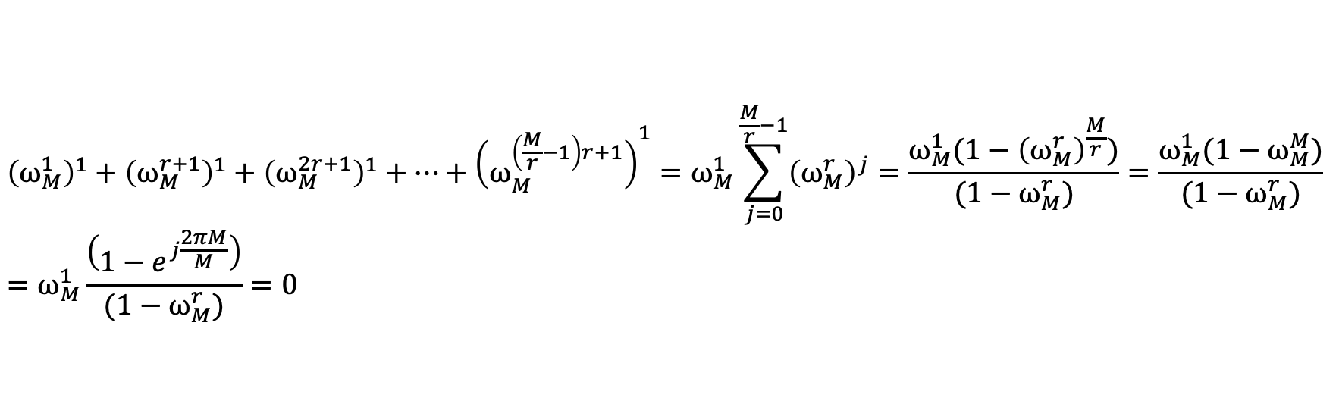
Shor’s algorithm
Suppose $\left.|f(blue)\right\rangle$ is measured, then$\frac{1}{\sqrt{M/r}}\left[\begin{aligned}0 \\ 1 \\ 0 \\ 0 \\ 0 \\ 1 \\ . \\ .\end{aligned}\right]$
$$\frac{\sqrt{r}}{M}\left\lceil \begin{aligned}{\left(ω_{M}^{0}\right)}^{0} \\ {\left(ω_{M}^{0}\right)}^{1} \\ {\left(ω_{M}^{0}\right)}^{2} \\ . \\ . \\ .\end{aligned}\begin{aligned}{\left(ω_{M}^{1}\right)}^{0} \\ {\left(ω_{M}^{1}\right)}^{1} \\ {\left(ω_{M}^{1}\right)}^{2} \\ . \\ . \\ .\end{aligned}\begin{aligned}{\left(ω_{M}^{2}\right)}^{0} \\ {\left(ω_{M}^{2}\right)}^{1} \\ {\left(ω_{M}^{2}\right)}^{2} \\ . \\ . \\ .\end{aligned}\begin{aligned}{\left(ω_{M}^{3}\right)}^{0} \\ {\left(ω_{M}^{3}\right)}^{1} \\ {\left(ω_{M}^{3}\right)}^{2} \\ . \\ . \\ .\end{aligned} \begin{aligned}. \\ . \\ \\ . \\ \\ . \\ . \\ .\end{aligned} \begin{aligned}. \\ . \\ \\ . \\ \\ . \\ . \\ .\end{aligned}\right\rceil$$
$$\left[\begin{aligned}0 \\ 1 \\ 0 \\ 0 \\ 0 \\ 1 \\ . \\ .\end{aligned}\right]=\frac{1}{\sqrt{r}}\left[\begin{aligned}1 \\ 0 \\ . \\ . \\ e^{j\frac{2π}{r}} \\ . \\ . \\ e^{j\frac{4π}{r}} \\ . \\ .\end{aligned}\right]$$
$$M/r$$
$$r$$
$$M/r$$
$${\left(ω_{M}^{1}\right)}^{1}+{\left(ω_{M}^{r+1}\right)}^{1}+{\left(ω_{M}^{2r+1}\right)}^{1}+…+{\left(ω_{M}^{\left(\frac{M}{r}−1\right)r+1}\right)}^{1}=ω_{M}^{1}\sum_{j=0}^{\frac{M}{r}−1}{{\left(ω_{M}^{r}\right)}^{j}}=\frac{ω_{M}^{1}(1−{\left(ω_{M}^{r}\right)}^{\frac{M}{r}}\text{)}}{(1−ω_{M}^{r}\text{)}}=\frac{ω_{M}^{1}(1−ω_{M}^{M}\text{)}}{(1−ω_{M}^{r}\text{)}}$$
$$=ω_{M}^{1}\frac{\left(1−e^{j\frac{2πM}{M}}\right)}{(1−ω_{M}^{r}\text{)}}=0$$

Slide 32
Shor’s algorithm
Suppose $\left.|f(blue)\right\rangle$ is measured, then$\frac{1}{\sqrt{M/r}}\left[\begin{aligned}0 \\ 1 \\ 0 \\ 0 \\ 0 \\ 1 \\ . \\ .\end{aligned}\right]$
$$\frac{\sqrt{r}}{M}\left\lceil \begin{aligned}{\left(ω_{M}^{0}\right)}^{0} \\ {\left(ω_{M}^{0}\right)}^{1} \\ {\left(ω_{M}^{0}\right)}^{2} \\ . \\ . \\ .\end{aligned}\begin{aligned}{\left(ω_{M}^{1}\right)}^{0} \\ {\left(ω_{M}^{1}\right)}^{1} \\ {\left(ω_{M}^{1}\right)}^{2} \\ . \\ . \\ .\end{aligned}\begin{aligned}{\left(ω_{M}^{2}\right)}^{0} \\ {\left(ω_{M}^{2}\right)}^{1} \\ {\left(ω_{M}^{2}\right)}^{2} \\ . \\ . \\ .\end{aligned}\begin{aligned}{\left(ω_{M}^{3}\right)}^{0} \\ {\left(ω_{M}^{3}\right)}^{1} \\ {\left(ω_{M}^{3}\right)}^{2} \\ . \\ . \\ .\end{aligned} \begin{aligned}. \\ . \\ \\ . \\ \\ . \\ . \\ .\end{aligned} \begin{aligned}. \\ . \\ \\ . \\ \\ . \\ . \\ .\end{aligned}\right\rceil$$
$$\left[\begin{aligned}0 \\ 1 \\ 0 \\ 0 \\ 0 \\ 1 \\ . \\ .\end{aligned}\right]=\frac{1}{\sqrt{r}}\left[\begin{aligned}1 \\ 0 \\ . \\ . \\ e^{j\frac{2π}{r}} \\ . \\ . \\ e^{j\frac{4π}{r}} \\ . \\ .\end{aligned}\right]$$
$$M/r$$
$$r$$
$$M/r$$
$${\left(ω_{M}^{1}\right)}^{c}+{\left(ω_{M}^{r+1}\right)}^{c}+{\left(ω_{M}^{2r+1}\right)}^{c}+…+{\left(ω_{M}^{\left(\frac{M}{r}−1\right)r+1}\right)}^{c}=e^{j\frac{2πc}{M}}\frac{M}{r}=e^{j\frac{2π}{r}}\frac{M}{r}$$

Slide 33
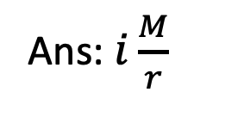
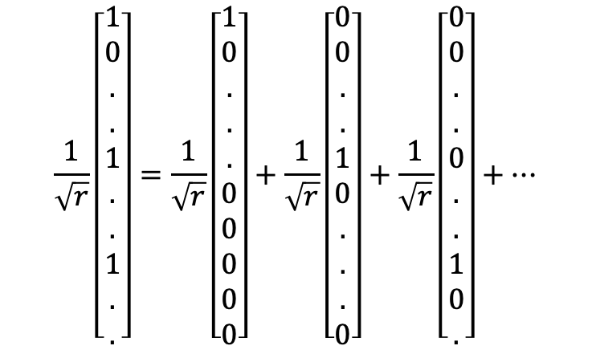
Shor’s algorithm
$$\frac{1}{\sqrt{r}}\left[\begin{aligned}1 \\ 0 \\ . \\ . \\ 1 \\ . \\ . \\ 1 \\ . \\ .\end{aligned}\right]=\frac{1}{\sqrt{r}}\left[\begin{aligned}1 \\ 0 \\ . \\ . \\ . \\ 0 \\ 0 \\ 0 \\ 0 \\ 0\end{aligned}\right]+\frac{1}{\sqrt{r}}\left[\begin{aligned}0 \\ 0 \\ . \\ . \\ 1 \\ 0 \\ . \\ . \\ . \\ 0\end{aligned}\right]+\frac{1}{\sqrt{r}}\left[\begin{aligned}0 \\ 0 \\ . \\ . \\ 0 \\ . \\ . \\ 1 \\ 0 \\ .\end{aligned}\right]+…$$
Ans: $i\frac{M}{r}$

Slide 34
Outline
Shor’s algorithm
Grover’s search algorithm
  Central idea
  Circuit

Slide 35





Grover search algorithm
Problem statement: Given an unstructured list $x=\{00…0,00…1,…,11…1\},$ and a ‘black box’ function (oracle) $f(x)$, such that $f\left(x\right)=\left\{\begin{aligned}0 ∀ x≠x_{w} \\ 1 ∀ x=x_{w}\end{aligned}\right.$;
Find $x_{w}$?
$$00…0$$
$$00…1$$
0
1
..
$$01…1$$
..
$$11…1$$

Slide 36












Central idea (Sketch of algorithm)
Step 1: Take advantage of superposition to create a uniform superposition of input states:
$$|\left.s\right\rangle =\frac{1}{\sqrt{N}}\{|\left.00…0\right\rangle +|\left.00…1\right\rangle +…+|\left.x_{w}\right\rangle +…+|\left.11..1\right\rangle \}$$
$$|\left.x_{w}\right\rangle$$
$$|\left.s\right\rangle$$
$$x_{w}$$
$$|\left.s^{′}\right\rangle =|\left.s\right\rangle −|\left.x_{w}\right\rangle$$
Query the oracle in such a way that the output state has the amplitude for $x_{w}$ flipped
$$|\left.s\right\rangle$$
$$θ$$
$$|\left.s^{′}\right\rangle =|\left.s\right\rangle −|\left.x_{w}\right\rangle$$
$$θ$$
$$x_{w}$$
$$|\left.x_{w}\right\rangle$$
Output after step 1
$$|\left.s_{1}\right\rangle =\frac{1}{\sqrt{N}}\{|\left.00…0\right\rangle +|\left.00…1\right\rangle +…−|\left.x_{w}\right\rangle +…+|\left.11..1\right\rangle \}$$

Slide 37












Central idea (Sketch of algorithm)
After Step 1:
$$|\left.s\right\rangle$$
$$θ$$
$$|\left.s^{′}\right\rangle =|\left.s\right\rangle −|\left.x_{w}\right\rangle$$
$$θ$$
$$x_{w}$$
$$|\left.x_{w}\right\rangle$$
Output after step 1
Step 2: Apply a unitary transformation to the step 1 to rotate about the uniform superposition state
Amplitude amplification
$$|\left.s\right\rangle$$
2$θ$
$$θ$$
$$|\left.s^{′}\right\rangle =|\left.s\right\rangle −|\left.x_{w}\right\rangle$$
$$θ$$
$$|\left.x_{w}\right\rangle$$
Output after step 1
$$x_{w}$$

Slide 38



Central idea (Sketch of algorithm)
After Step 1 & 2:
Rotated towards the winner state
Amplitude amplification
$$|\left.x_{w}\right\rangle$$
$$x_{w}$$
Just keep on repeating until you get “sufficiently” close to the winner state
  At least with probability $>\frac{1}{2}$
How many steps are needed?

Slide 39








Central idea (Sketch of algorithm)
How many states needed?
Two cycle:
Three cycle:
One cycle:
4$θ$
6$θ$
$$|\left.s\right\rangle$$
$$|\left.s\right\rangle$$
$$|\left.s\right\rangle$$
2$θ$
2$θ$
$$θ$$
$$θ$$
$$θ$$
3$θ$

Slide 40




Central idea (Sketch of algorithm)
How many states needed?
Two cycle:
Three cycle:
One cycle:
4$θ$
6$θ$
$$|\left.s\right\rangle$$
$$|\left.s\right\rangle$$
$$|\left.s\right\rangle$$
2$θ$
2$θ$
$$θ$$
$$θ$$
$$θ$$
3$θ$
In $M$ cycles, $α=2Mθ≈2M\frac{1}{\sqrt{N}}$
$$\sin{θ=\frac{1}{\sqrt{2^{n}}}=\frac{1}{\sqrt{N}}}\overset{\text{yields}}{→}θ≈\frac{1}{\sqrt{N}}$$
$$2M\frac{1}{\sqrt{N}}=\frac{π}{2}$$
$$M=O(\sqrt{N})$$

Slide 41







Central idea (Sketch of algorithm)
Step 1: Take advantage of superposition to create a uniform superposition of input states:
$$|\left.s\right\rangle =\frac{1}{\sqrt{N}}\{|\left.00…0\right\rangle +|\left.00…1\right\rangle +…+|\left.x_{w}\right\rangle +…+|\left.11..1\right\rangle \}$$
$$|\left.x_{w}\right\rangle$$
$$|\left.s\right\rangle$$
$$x_{w}$$
$$|\left.s^{′}\right\rangle =|\left.s\right\rangle −|\left.x_{w}\right\rangle$$
Query the oracle in such a way that the output state has the amplitude for $x_{w}$ flipped
$$|\left.x_{w}\right\rangle$$
$$|\left.s\right\rangle$$
$$x_{w}$$
$$|\left.s^{′}\right\rangle =|\left.s\right\rangle −|\left.x_{w}\right\rangle$$

Slide 42
Outline
Shor’s algorithm
Grover’s search algorithm
  Central idea
  Circuit
    Step 1
    Step 2

Slide 43




Grover algorithm
$$|{\left.0\right\rangle }^{⊗n}$$
$$\left.|x\right\rangle$$
$$\left.|x\right\rangle$$
$$H^{⊗n}$$
$$U_{f}$$
$$\left.|y\right\rangle$$
$$\left.|y⊕f(x)\right\rangle$$
$$|\left.−\right\rangle$$
$$|\left.Ψ_{0}\right\rangle$$
$$|\left.Ψ_{1}\right\rangle$$
$$|\left.Ψ_{2}\right\rangle$$
$$|\left.Ψ_{1}\right\rangle =|\left.−\right\rangle ⊗\frac{1}{\sqrt{2^{n}}}\sum_{d∈{\left\{0,1\right\}}^{n}}{|\left.d\right\rangle }$$

Slide 44

Grover algorithm
$$|{\left.0\right\rangle }^{⊗n}$$
$$\left.|x\right\rangle$$
$$\left.|x\right\rangle$$
$$H^{⊗n}$$
$$U_{f}$$
$$\left.|y\right\rangle$$
$$\left.|y⊕f(x)\right\rangle$$
$$|\left.−\right\rangle$$
$$|\left.Ψ_{0}\right\rangle$$
$$|\left.Ψ_{1}\right\rangle$$
$$|\left.Ψ_{2}\right\rangle$$
$$|\left.Ψ_{1}\right\rangle =|\left.−\right\rangle ⊗\frac{1}{\sqrt{2^{n}}}\sum_{d∈{\left\{0,1\right\}}^{n}}{|\left.d\right\rangle }$$
$$|\left.Ψ_{2}\right\rangle =\frac{1}{\sqrt{2^{n+1}}}\left(\sum_{d∈{\left\{0,1\right\}}^{n}}{\left|\left.0⊕f\left(d\right)\right\rangle \right|\left.d\right\rangle }−\sum_{d∈{\left\{0,1\right\}}^{n}}{|\left.1⊕f(d)\right\rangle |\left.d\right\rangle }\right)$$

Slide 45

Grover algorithm
$$|{\left.0\right\rangle }^{⊗n}$$
$$\left.|x\right\rangle$$
$$\left.|x\right\rangle$$
$$H^{⊗n}$$
$$U_{f}$$
$$\left.|y\right\rangle$$
$$\left.|y⊕f(x)\right\rangle$$
$$|\left.−\right\rangle$$
$$|\left.Ψ_{0}\right\rangle$$
$$|\left.Ψ_{1}\right\rangle$$
$$|\left.Ψ_{2}\right\rangle$$
$$|\left.Ψ_{1}\right\rangle =|\left.−\right\rangle ⊗\frac{1}{\sqrt{2^{n}}}\sum_{d∈{\left\{0,1\right\}}^{n}}{|\left.d\right\rangle }$$
$$|\left.Ψ_{2}\right\rangle =\frac{1}{\sqrt{2^{n+1}}}\left(\sum_{d∈{\left\{0,1\right\}}^{n}}{\left|\left.f\left(d\right)\right\rangle \right|\left.d\right\rangle }−\sum_{d∈{\left\{0,1\right\}}^{n}}{|\left.\overset{¯}{f(d)}\right\rangle |\left.d\right\rangle }\right)$$

Slide 46

Grover algorithm
$$|{\left.0\right\rangle }^{⊗n}$$
$$\left.|x\right\rangle$$
$$\left.|x\right\rangle$$
$$H^{⊗n}$$
$$U_{f}$$
$$\left.|y\right\rangle$$
$$\left.|y⊕f(x)\right\rangle$$
$$|\left.−\right\rangle$$
$$|\left.Ψ_{0}\right\rangle$$
$$|\left.Ψ_{1}\right\rangle$$
$$|\left.Ψ_{2}\right\rangle$$
$$|\left.Ψ_{1}\right\rangle =|\left.−\right\rangle ⊗\frac{1}{\sqrt{2^{n}}}\sum_{d∈{\left\{0,1\right\}}^{n}}{|\left.d\right\rangle }$$
$$|\left.Ψ_{2}\right\rangle =|\left.−\right\rangle ⊗\frac{1}{\sqrt{2^{n}}}\left\{\left(\sum_{d∈{\left\{0,1\right\}}^{n},d≠|\left.x_{w}\right\rangle }{|\left.d\right\rangle }\right)−|\left.x_{w}\right\rangle \right\}$$

Slide 47
Outline
Shor’s algorithm
Grover’s search algorithm
  Central idea
  Circuit
    Step 1
    Step 2

Slide 48








Coordinate transformation
$$|\left.s\right\rangle$$
$$|\left.s\right\rangle$$
2$θ$
$$θ$$
$$|\left.s\right\rangle$$
2$θ$
$$θ$$
$$|\left.s\right\rangle$$
$$θ$$
2$θ$
$$|\left.00…0\right\rangle$$

Slide 49


Coordinate transformation
$$|\left.s\right\rangle$$
$$|\left.s\right\rangle$$
2$θ$
$$θ$$
$$|\left.s\right\rangle$$
2$θ$
$$θ$$
$$|\left.s\right\rangle$$
$$θ$$
2$θ$
$$|\left.00…0\right\rangle$$
$$H^{⊗n}$$
$$H^{⊗n}$$

Slide 50






Flipping
$$|\left.00…0\right\rangle =\left[\begin{aligned}1 \\ 0 \\ 0 \\ . \\ . \\ . \\ 0\end{aligned}\right]$$
$$|\left.00…1\right\rangle =\left[\begin{aligned}0 \\ 1 \\ 0 \\ . \\ . \\ . \\ 0\end{aligned}\right]$$
$$−|\left.00…1\right\rangle =\left[\begin{aligned}0 \\ −1 \\ 0 \\ . \\ . \\ . \\ 0\end{aligned}\right]$$
$$|\left.s\right\rangle$$
2$θ$
$$|\left.00…0\right\rangle$$
$$U=\left[\begin{aligned} \begin{aligned}\begin{matrix}1 & 0 \\ 0 & −1\end{matrix} \begin{matrix}0 & 0 \\ 0 & 0\end{matrix} \\ \begin{matrix}0 & 0 \\ . & .\end{matrix} \begin{matrix}−1 & 0 \\ . & .\end{matrix}\end{aligned} \begin{aligned}\begin{matrix}0 & . \\ 0 & 0\end{matrix} \begin{matrix}. & . \\ . & .\end{matrix} \\ \begin{matrix}0 & 0 \\ . & .\end{matrix} \begin{matrix}0 & . \\ . & .\end{matrix}\end{aligned} \\ \end{aligned}\right]$$

Slide 51






Step 2 (Circuit)
$$\left.|x\right\rangle$$
$$\left.|x\right\rangle$$
$$H^{⊗n}$$
$$H^{⊗n}$$
$$U_{g}$$
$$\left.|y\right\rangle$$
$$\left.|y⊕f(x)\right\rangle$$
$$|\left.−\right\rangle$$
$$00…0$$
0
1
$$\sim (|\left.0\right\rangle −|\left.1\right\rangle )⊗|\left.x\right\rangle$$
If $x=00…0$, then $\sim (|\left.0\right\rangle −|\left.1\right\rangle )⊗|\left.x\right\rangle$
Else $\sim −(|\left.0\right\rangle −|\left.1\right\rangle )⊗|\left.x\right\rangle$
$$00…1$$
..
$$\sim (|\left.g(x)\right\rangle −|\left.\overset{¯}{g(x)}\right\rangle )⊗|\left.x\right\rangle$$
$$11…1$$

Slide 52
Thanks for your attention &
Questions ?

